Slide 1
ARTIFICIAL NEURAL NETWORKS

Slide 2
Contents
ARTIFICIAL NEURAL NETWORKS: –
Perception’s, Multilayer perceptron, Gradient descent and the Delta rule, Multilayer networks, Derivation of Backpropagation Algorithm, Generalization, Unsupervised Learning – SOM Algorithm and its variant;
DEEP LEARNING: –
Introduction, concept of convolutional neural network , Types of layers – (Convolutional Layers , Activation function , pooling , fully connected) , Concept of Convolution (1D and 2D) layers, Training of network, Case study of CNN for eg on Diabetic Retinopathy, Building a smart speaker, Self-deriving car etc.

Slide 3

Perception’s
One type of ANN system is based on a unit called a perceptron.
A perceptron takes a vector of real-valued inputs, calculates a linear combination of these inputs, then outputs a 1 if the result is greater than some threshold and -1 otherwise.
More precisely, given inputs x₁ through x_{n} the output o(x₁, . . . , x_{n} ) computed by the perceptron is:
where each w_{i} is a real-valued constant, or weight, that determines the contribution of input x_{i} to the perceptron output.
Notice the quantity (w₀ is a threshold that the weighted combination of inputs w_{i} x_{i} + . . . + w_{n} x_{n} must surpass in order for the perceptron to output a 1.

Slide 4
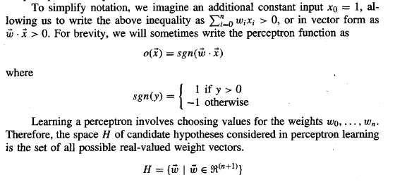
Perception’s

Slide 5
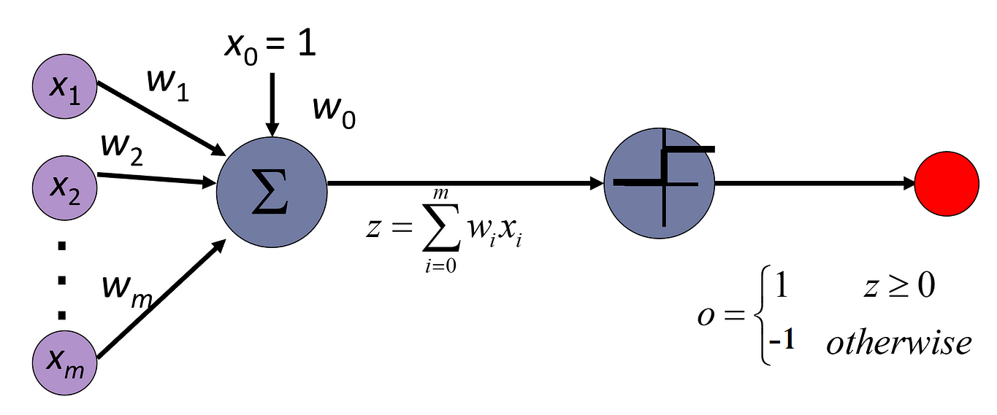
Representational Power of Perceptron
We can view the perceptron as representing a hyperplane decision surface in the n-dimensional space of instances (i.e., points).
The perceptron outputs a 1 for instances lying on one side of the hyperplane and outputs a -1 for instances lying on the other side, as illustrated in figure given below:

Slide 6
Representational Power of Perceptron
The equation for this decision hyperplane is Of course, some sets of positive and negative examples cannot be separated by any hyperplane.
Those that can be separated are called linearly separable sets of examples.
A single perceptron can be used to represent many boolean functions.
For example, if we assume boolean values of 1 (true) and -1 (false), then one way to use a two-input perceptron to implement the AND function is to set the weights w₀ = -.8 and w₁ = w₂ = -.5.
This perceptron can be made to represent the OR function instead by altering the threshold to w₀ = -.3.

Slide 7
Representational Power of Perceptron
The ability of perceptrons to represent AND, OR, NAND, and NOR is important because every boolean function can be represented by some network of interconnected units based on these primitives.
In fact, every boolean function can be represented by some network of perceptrons only two levels deep, in which the inputs are fed to multiple units, and the outputs of these units are then input to a second, final stage.
One way is to represent the boolean function in disjunctive normal form (i.e., as the disjunction (OR) of a set of conjunctions (ANDs) of the inputs and their negations).
Note that the input to an AND perceptron can be negated simply by changing the sign of the corresponding input weight.
Because networks of threshold units can represent a rich variety of functions and because single units alone cannot, we will generally be interested in learning multilayer networks of threshold units.

Slide 8
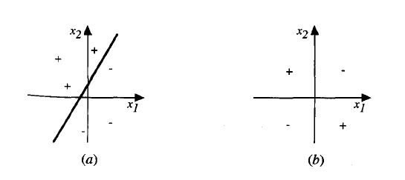
Representational Power of Perceptron
Perceptrons can represent all of the primitive boolean functions AND, OR, NAND, and NOR.
Unfortunately, however, some boolean functions cannot be represented by a single perceptron, such as the XOR function whose value is 1 if and only if X₁≠ X₂
Note the set of linearly non-separable training examples shown in Figure (b) corresponds to this XOR function.
A set of training examples and the decision surface of a perceptron that classifies them correctly.
A set of training examples that is not linearly separable (i.e., that cannot be correctly classified by any straight line). X₁ and X₂ are the Perceptron inputs, positive examples are indicated by "+", negative by "-“.

Slide 9
The Perceptron Training Rule
Challenging task is how to learn the weights for a single perceptron.
Here the precise learning problem is to determine a weight vector that causes the perceptron to produce the correct +1 and -1 output for each of the given training examples.
Several algorithms are known to solve this learning problem, the perceptron rule and the delta rule.
These two algorithms are guaranteed to converge to somewhat different acceptable hypotheses, under somewhat different conditions.
They are important to ANNs because they provide the basis for learning networks of many units.
One way to learn an acceptable weight vector is to begin with random weights.
Then iteratively apply the perceptron to each training example, modifying the perceptron weights whenever it misclassifies an example.

Slide 10
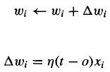
The Perceptron Training Rule
This process is repeated, iterating through the training examples as many times as needed until the perceptron classifies all training examples correctly.
Weights are modified at each step according to the perceptron training rule, which revises the weight w_{i} associated with input x_{i} according to the rule. where
Here t is the target output for the current training example, o is the output generated by the perceptron, and η is a positive constant called the learning rate.
The role of the learning rate is to moderate the degree to which weights are changed at each step.
It is usually set to some small value (e.g., 0.1) and is sometimes made to decay as the number of weight-tuning iterations increases.

Slide 11
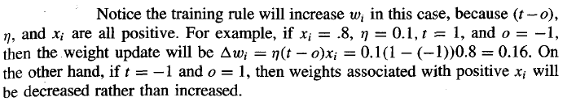
The Perceptron Training Rule
Suppose the training example is correctly classified already by the perceptron.
In this case, ( t - o) is zero, making zero, so that no weights are updated.
Suppose the perceptron outputs a -1, when the target output is + 1.
To make the perceptron output a + 1 instead of - 1 in this case, the weights must be altered to increase the value of .
For example, if x_{i} >0, then increasing w_{i} will bring the perceptron closer to correctly classifying this example.

Slide 12
The Perceptron Training Rule
In fact, the above learning procedure can be proven to converge within a finite number of applications of the perceptron training rule to a weight vector that correctly classifies all training examples.
Provided the training examples are linearly separable and provided a sufficiently small η is used.
If the data are not linearly separable, convergence is not assured

Slide 13
Gradient Descent and the Delta Rule
A second training rule, called the delta rule, is designed to overcome non linearly separable case in perceptron rule.
If the training examples are not linearly separable, the delta rule converges toward a best-fit approximation to the target concept.
The key idea behind the delta rule is to use gradient descent to search the hypothesis space of possible weight vectors to find the weights that best fit the training examples.
This rule is important because gradient descent provides the basis for the BACKPROPAGATION algorithm, which can learn networks with many interconnected units.
It is also important because gradient descent can serve as the basis for learning algorithms that must search through hypothesis spaces containing many different types of continuously parameterized hypotheses.

Slide 14


Gradient Descent and the Delta Rule
The delta training rule is best understood by considering the task of training an unthresholded perceptron; that is, a linear unit for which the output o is given by
Thus, a linear unit corresponds to the first stage of a perceptron, without the threshold.
In order to derive a weight learning rule for linear units, let us begin by specifying a measure for the training error of a hypothesis (weight vector), relative to the training examples.
where D is the set of training examples, t_{d} is the target output for training exampled, and o_{d} is the output of the linear unit for training example d.

Slide 15
VISUALIZING THE HYPOTHESIS SPACE
For a linear unit with two weights, the hypothesis space H is the w₀ and w₁ plane.
The vertical axis indicates tk error of the corresponding weight vector hypothesis, relative to a fixed set of training examples.
The arrow shows the negated gradient at one particular point, indicating the direction in the w₀ and w₁ plane producing steepest descent along the error surface.
Gradient descent search determines a weight vector that minimizes E by starting with an arbitrary initial weight vector, then repeatedly modifying it in small steps.
At each step, the weight vector is altered in the direction that produces the steepest descent along the error surface depicted in Figure .
This process continues until the global minimum error is reached.

Slide 16
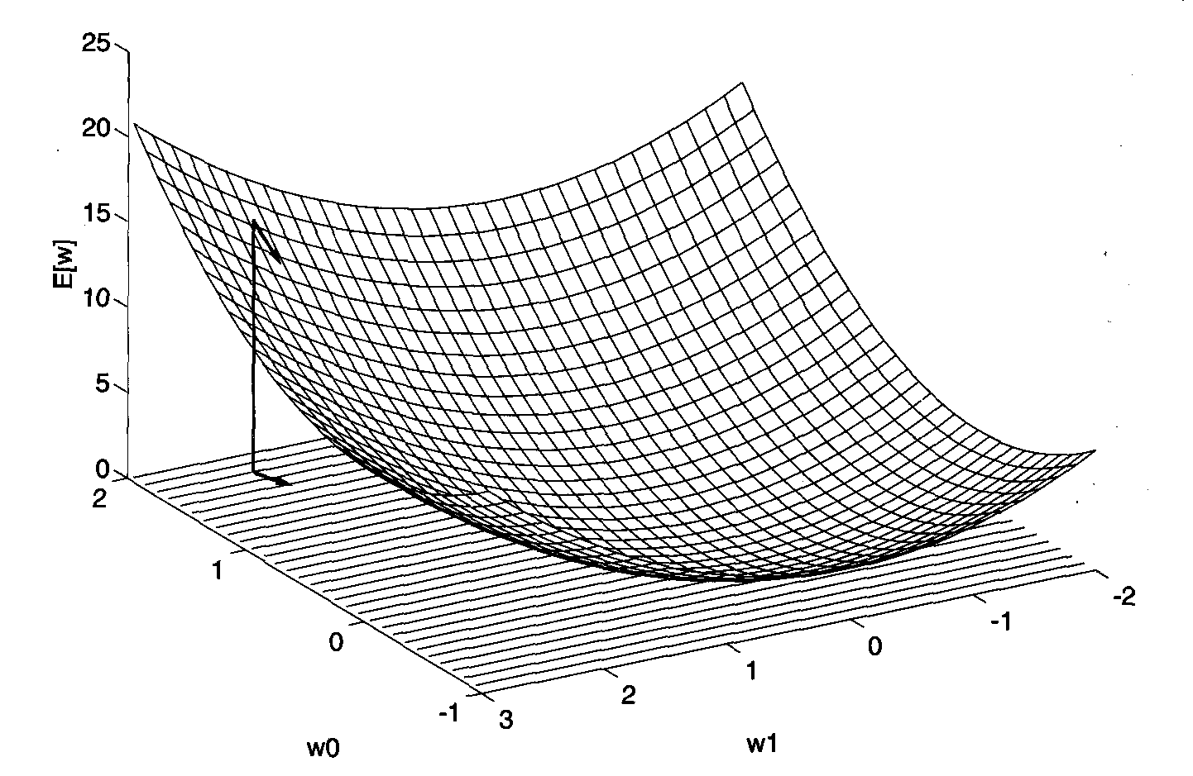
VISUALIZING THE HYPOTHESIS SPACE

Slide 17
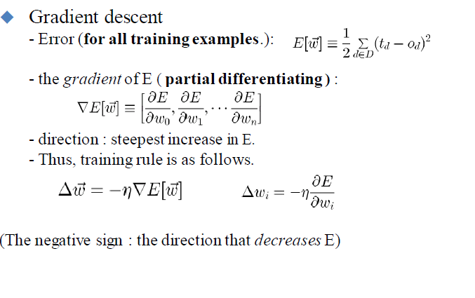
DERIVATION OF THE GRADIENT DESCENT RULE
The delta training rule is best understood by considering the task of training an unthresholded perceptron; that is, a linear unit for which the output o is given by

Slide 18
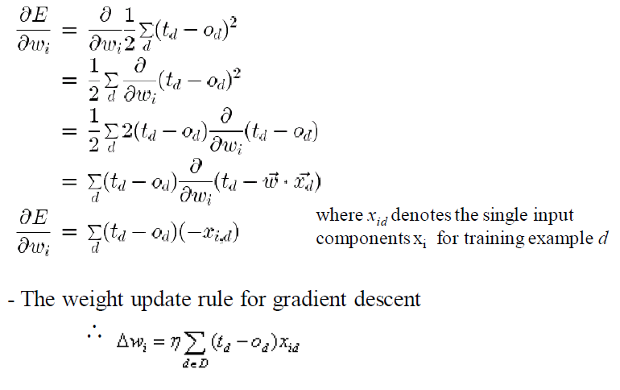
DERIVATION OF THE GRADIENT DESCENT RULE

Slide 19
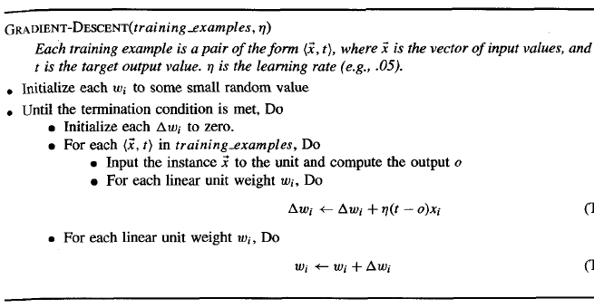
DERIVATION OF THE GRADIENT DESCENT RULE

Slide 20
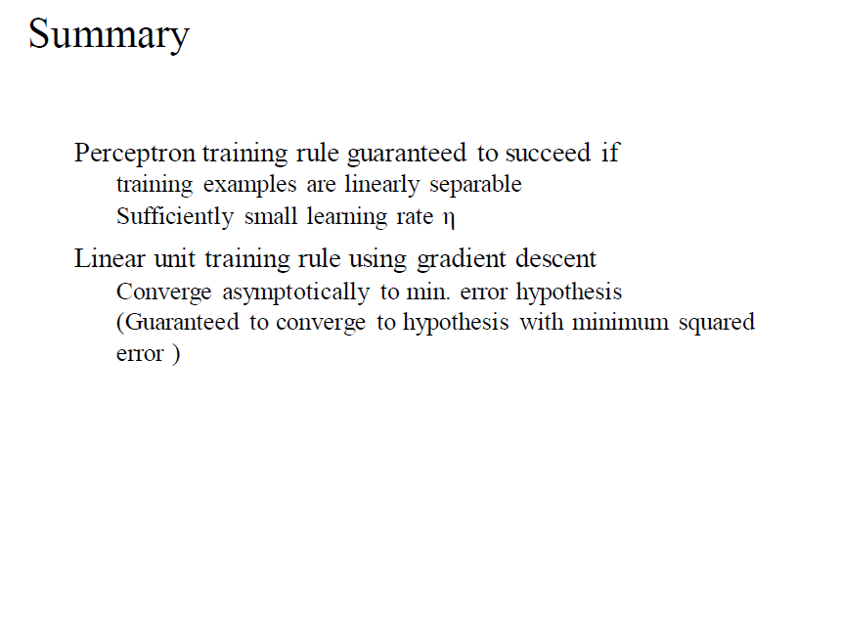
DERIVATION OF THE GRADIENT DESCENT RULE

Slide 21
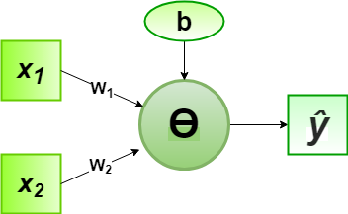
Implementation of Perceptron Algorithm for AND Logic Gate with 2-bit Binary Input
In the field of Machine Learning, the Perceptron is a Supervised Learning Algorithm for binary classifiers.
The Perceptron Model implements the following function:

Slide 22
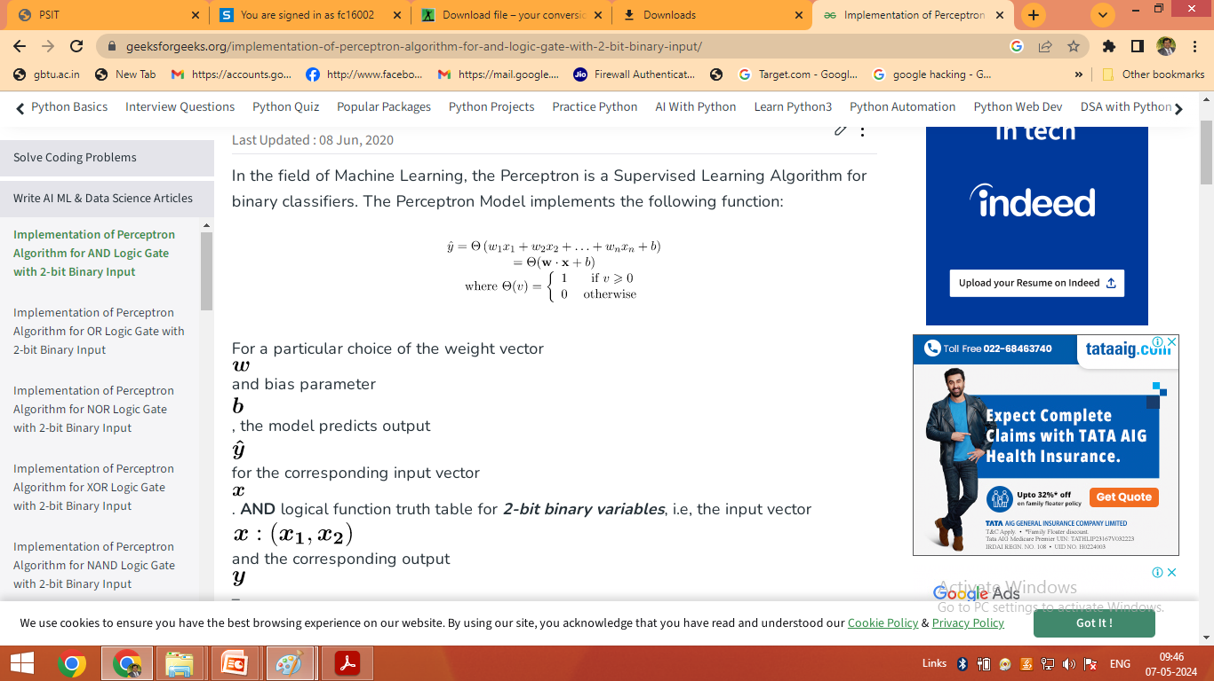
Implementation of Perceptron Algorithm for AND Logic Gate with 2-bit Binary Input

Slide 23


Slide 24
